Slide 1
NAME :samir kumar roll no:19155086 sr. No:ae-104 (b.tech) mine practice
Assigment 2:
What are the automation techniques used in mining industries?

Slide 2
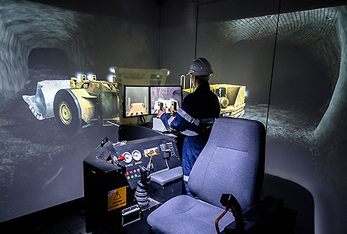
INTRODUCTION
Automation is broadly Defined as the intelligent Management of a system using Appropriate technology so That its operation can occur
Type to enter a caption.
Without direct human involvement.robotics in mines is an Enabling technology that is able to improve the performance of all the remote operation processes.(eg.
LHD driving, drills holes, driving of heavy machines.

Slide 3
TYPES OF AUTOMATION
Different level of automation can be identified between these two extremes. In the mining domain separate automation and new technologies into three broad categories based system control -
1.lower level automation 2.mid level automation 3.full automation
The following discrete level have been identified to provide context for identifying the desired automation level -
4.tele-supervision 5.full automation
1.local manual control 2.remote manual control 3.tele-operation

Slide 4
NEED OF AUTOMATION
Automation In the mining industries workplace provides the advantage improving productivity and quality while reducing error And waste, increasing safety, and adding flexibility to the manufacturing process.there are following reasons that we need industrial automation-
reduce worker fatigue and effort or labor expensive operation
prevents product and materials
prevent non confirmed product from shipping 4.increase efficiency
5.collet better data 6.improve metrics
7.devise the write process improvements 8.save money
9.health and safety issue 10.time saving
11.environment impact of mining

Slide 5

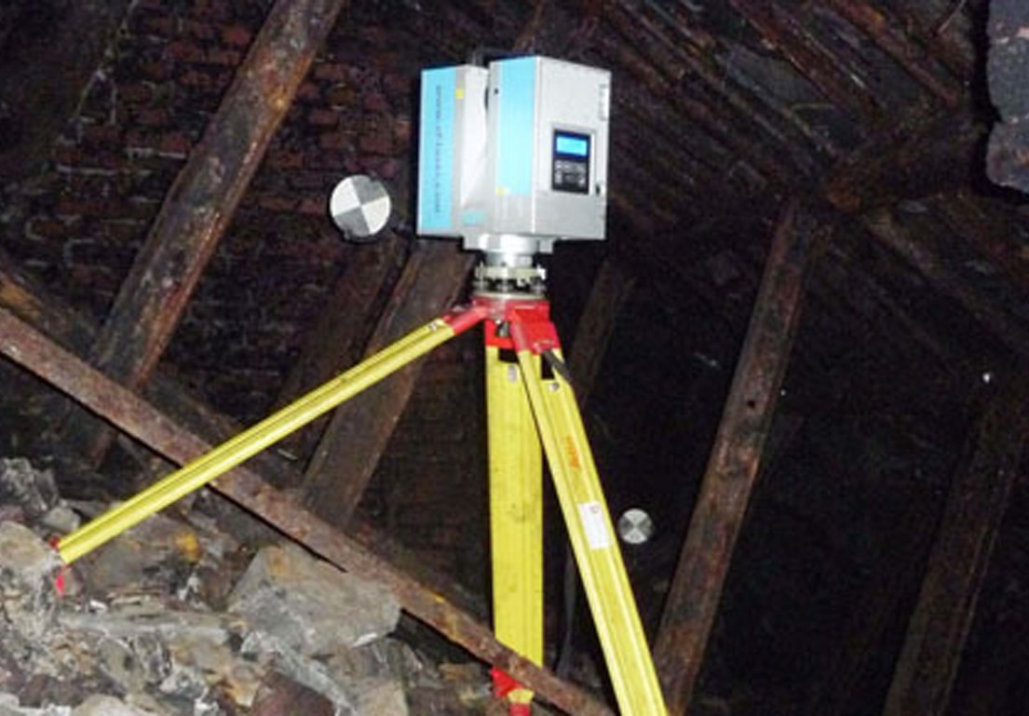
SOME EXAMPLE OF AUTOMATION IN MINING INDUSTRIES
3D LASER SCANNING
Laser scanning is a remote Sensing technology which Uses laser beam to measure The position of surface or Targeted feature. It is also Used for the accurate map, And interpret geological Structure in a pit.

Slide 6
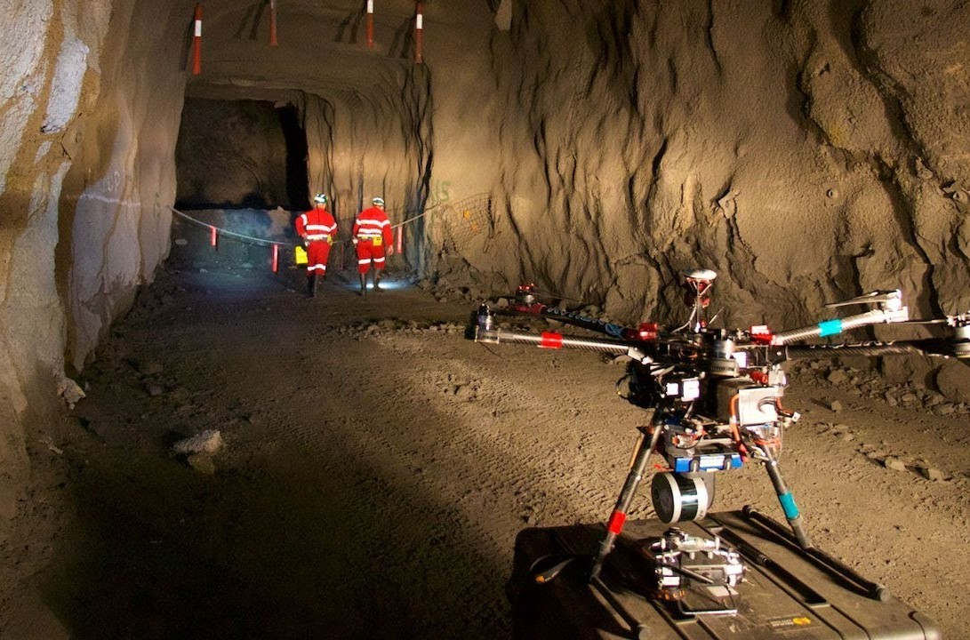
SURVEYING VEHICLES
DRONES
Drones in mining Improve the overall Efficiency of large mine Site and quarry Management by Providing accurate and
Compressive data detailing site in a very short time.they also support better condition among teams onsite and internationally, offering dynamic oversight of all operation.

Slide 7
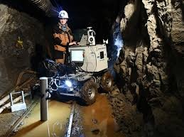
ROBOTICS IN MINING
To address the existence of subterranean void space Below ground , a robotic tool has been developed that is
Capable of reaching a dome out vie borehole access, acquiring The measurement necessary for void analysis, and relaying this Information to the surface.

Slide 8
INTERNET AND INFORMATION SUPERHIGHWAY
Quickest and accurate information is vital to any Decision making process.
A no of website offer update and relevant information On coal and mineral exploration and exploitation.
information superhighway is the remote pc based Instrumentation system for continuous monitoring of a Mining system.
It is like a highway where all the expertise is readily Available for solving all kind of mining related problems.

Slide 9
GIS AND REMOTE SENSING
GIS can contribute in proving a safe working Environment in underground mining by performing Network analysis and determine the appropriate sites For refuge chambers and facilitate the prompt Evacuation of mine personnel.
GIS and remote sensing assist the planner in
Identifying natural hazards such as potential Landslides, floods, and earthquakes prior to the Construction of production and housing installation
GIS can be also used for the selection for the selection Of a housing site that meets safety , scenic, and Recreational requirement within reasonable proximity To the mining operation.

Slide 10

Picture by remote sensing

Slide 11

ADVANTAGE OF AUTOMATION

Slide 12
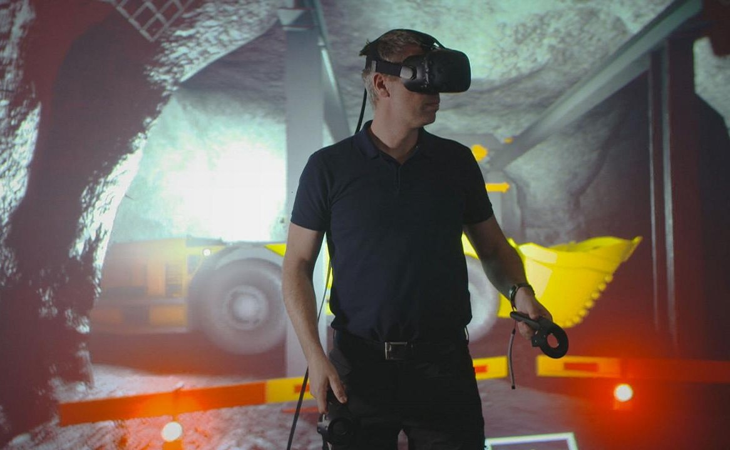
1.making mining safer through automation 2.safer mining through better oversight 3.environmental friendly mining
4.fewer hazard for workers 5.health and safety benefits
6. Economic benefits

Slide 13


DISADVANTAGE OF AUTOMATION
Less versatility
More pollution
Larger initial investment
Increase in unemployment
Unpredictable cost

Slide 14

BOTTLENECK’S OF AUTOMATION IN MINING
Technologies that are not accepted by operators.
Unless new technologies are designed effectively The information presented may create overloads, Distraction or even confusion to the operator. 3.automation also often fails because the role of the Person performing the task is often underestimated Particularly their ability to compensate for the unexpected.
loses situational awareness and over.
the main drawback of inertia navigation is sensitivity to the integration drift.

Slide 15
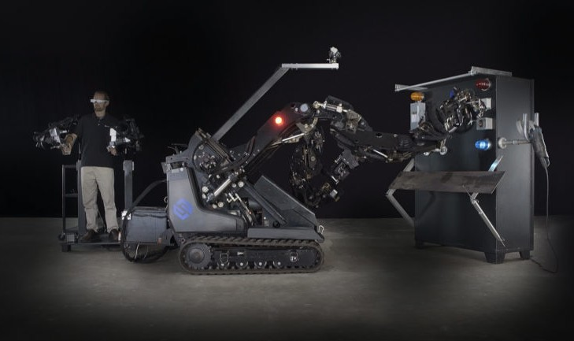
HUMAN FACTOR EFFECTS WITH AUTOMATION
1.Poor operation acceptance of new technologies 2.problem with integration of multiple warning. 3.lack of technology standardisation.
over reliance on the technology by operator.
the introduction of automation and new technology Can result in operation engaging in more risky Behaviours.
organisation issues
De skilling or wrong skills.

Slide 16

CONCLUSION
There is a substantial need of adoption of state of The art automation technologies in the mines to ensure The safety and to protect health of mineworkers.
semi automated and automated mining technologies Are backbone with information technologies is need Of the day.
this will satisfy the two important goals of any mining Operation: improve productivity and safer working Condition.

Slide 17
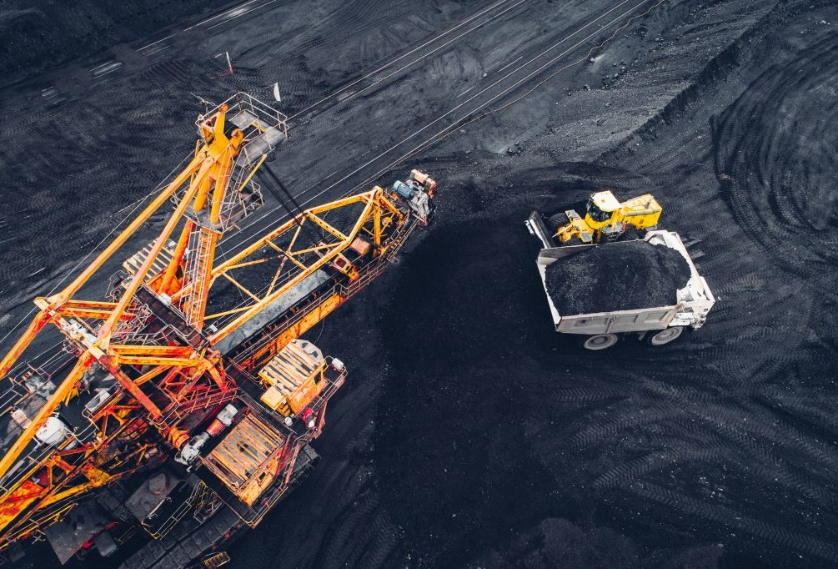
THANK YOU!!

